Slide 1

Tagore International School
Team SKAAR
Sharan Suri
Aditya Kabu
Ansh Bajaj
Anandiya Sheel Diwan
Ronit Das
Mentor: Kapish Malhotra
Notes:
Good evening Judges
Today the team SKAAR stands before you to pitch its unique and innovative AI & ML enabled adaptive traffic light
The team consists of
>Introduce yourself in order of SKAAR.

Slide 2

Contact us
Aditya Kabu Ansh Bajaj
+91 89206 78039 +91 96252 76565
kabuaditya1@gmail.com anshbajaj07@gmail.com
Sharan Suri
+91 70117 74092
sharansuri1980@gmail.com
Anandiya Sheel Diwan
+91 99109 01251
anandiya.sheel.diwan17@gmail.com
Ronit Das
+91 98185 40119
ronit.sudeep@gmail.com

Slide 3


Problem
1
In metropolitan cities we find that all traffic lights are non adaptive i.e run on fixed timings which are not affected by the traffic density
The traffic lights will complete its hard coded cycle before changing the signal for the progressive traffic. Which wastes a lot of time and contributes to global warming enormously.
SKAAR V1.0
2
3
Apart from the environmental concern, the traffic on roads results in delay for ambulances, fire engines and police to reach their destinations.
Notes:
1.In metropolitan cities there are traffic lights that are non adaptive which work on fixed cycles and hence are not affected by the traffic density.Basically what we mean is that they have the same countdown as when to put red,green or yellow light even if the traffic present before them is large.This causes a lot of chaos.
2. Usually these traffic lights complete its hard coded cycle before changing the signal for progressive traffic.This process is very time consuming and since these lights work slowly there is a lot of traffic that is left standalone which increases the carbon dioxide emissions and causes an increase in greenhouse gases thus leading to global warming.
3.In today’s world traffic doesn’t only concern our environment,it also causes a delay for ambulances,fire engines and police to reach their destinations which also results in a lot of deaths.

Slide 4

Our Solution [The Beginning]
We plan to Introduce self sufficient traffic system infused with AI, Deep ML which will be integrated with a raspberry pi module fitted on each traffic light with an external connection to a camera.
The traffic lights would alter their duration on the basis of an
pre-fed algorithm in the raspberry pi module which in turn
will optimize the availability of routes and reduce congestion.
We will also have the hard-coded version in idle state so
that the light doesn't malfunction in absence of electricity.
Most importantly it will lay down the framework
for a new system of traffic lights, thus implementing
Atma-Nirbhar Bharat
SKAAR V1.0
Notes:
However, in the off chance of any disturbance in the supply of electricity to the traffic lights, we have also kept a conventional hard coded version kept in the idle state as a backup, so that the light doesn't malfunction in absence of electricity.
More importantly, the framework for a completely new system of traffic lights which hasnt been seen anywhere in the country will be laid down through our project, thus implementing Atma-Nirbhar Bharat.

Slide 5
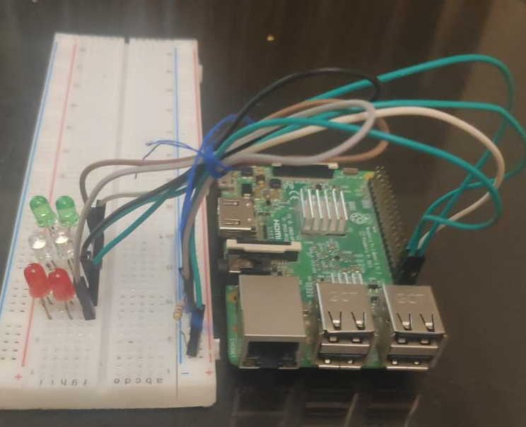
How Does Our Prototype Work?
Classification into
High_Traffic and Low_Traffic.
Video Stream
From the Camera
Open CV
Keras
Split Into Frames
Processed By the AI Engine
Checks For Manual Control Request
Control Handed Over
If True
If not True
State of the Traffic Light changed
Timings Calculated
SKAAR V1.0
Notes:
So how does it work? well first the video stream from the camera is broken up into frames, then these are converted into numpy arrays and then fed into our model, at this point the system checks for any requests for manual control of the traffic, if true then the control us handed over if false the system proceeds to calculate the new timings for the traffic light and implement them. This whole procedure runs indefinitely.

Slide 6
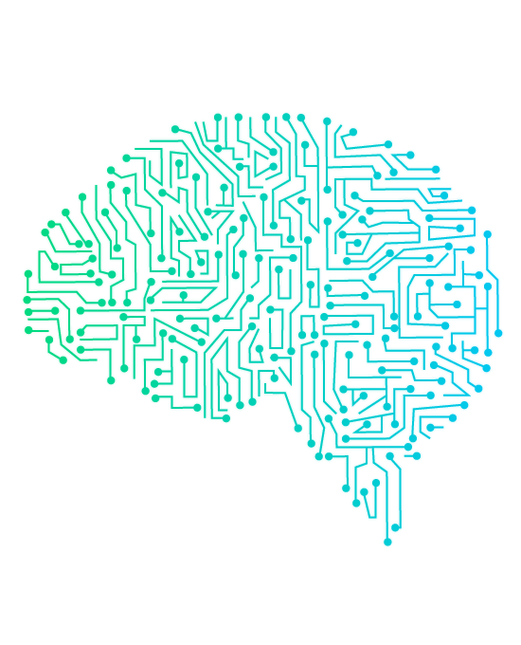
How is AI implemented?
The video stream received from the camera is passed through our AI, then based on the traffic conditions of the road, it is classified into 2 major classes.
High_Traffic and Low_Traffic depending on this the new timings of the traffic light(s) are decided
We have used a SLAM model type for our AI
SKAAR V1.0
Notes:
With OpenCV the real time video input will be broken into frames each of which is passed as an input for our keras model. The model then based of the presets fed, will analyse the image and give suitable output which will be in two categories that is High_Traffic and Low_Traffic. The output will be in form of a list with respective values for high and low. The values are then compared and the higher output is passed into the algorithm for switching the traffic light. The keras model is infused with AI for classifying images and ML to simultaneously better the classification and improve the predictive model.

Slide 7

Hardware and Software details.
Hardware Used:
Raspberry Pi 3/0
A USB compatible Camera, preferably weather-proof
Software Details:
The scripts that have to be executed are written in python,
The AI model is stored in a keras file.
Libraries Used:
Keras
OpenCV
PIL
NumPy
Socket
SKAAR V1.0
Notes:
All the scripts have been written in Python. Our model has been created with keras and tensorflow, we chose keras because it if efficient and can be deployed very easily. We have also used OpenCv which enabled us with real-time computer vision and allows us to capture video arrays as our input which were later converted into numpy arrays for the model to use.
Sharan:
To create this prototype we have used a RPi 3 and a usb webcam this version of the prototype can be made in under 3000 rupees. But the raspberry pi 3 can be swapped for the rpi 0 but that will be slower.
We are using socket to share data with a central server which will store data regarding traffic conditions of the streets on which this system will be deployed.

Slide 8

Our Solution [The Conclusion]
Our model is infused with a special mode that creates a 'green-corridor' for permitted vehicles which can be enabled via app.
We intend to run a prediction model so that we can predict the
future traffic conditions and make our system more efficient.
Moreover, we also plan to deploy an app that can give the user
average traffic conditions in their surroundings and optimize their
routes accordingly assisting them with ETAs and Shorter routes.
We can expand our model to cover intersections, T-points
and express highways.
SKAAR V1.0
Notes:
Kabu: Apart from all this our model has a special mode that allows any authorised vehicle to create a ‘green corridor’ for itself which can assist the police, fire trucks and emergency services to reduce their response time.
Since our keras enabled model comes equipped with machine learning, after sufficient amount of data and training we can successfully predict the traffic flows at different time frames of the day and accordingly change the time for the lights before hand.
Bajaj:Our future prospects involve deploying an app that would give the user average traffic conditions in their surroundings according to which they could choose the route which is more feasible although we would also be suggesting the user shorter routes along with the estimated arrival time.
We would expand our model to cover intesections,T-points and express highways which we believe would reduce the probability of accidents by a great margin.

Slide 9
Let's Talk Business

Slide 10

Our Learnings
Thanks to IBM and CBSE we learnt about practical implementation of our theoretical learning.
Apart from this, we learned to work together as a team, manage time limits and deadlines, tackle errors together and polish our skills in Python, Blender, Photoshop, IBM Cloud, Premiere Pro and learnt new skills like DB management and creating a model on AI and Deep ML.
SKAAR v01
Notes:
On behalf of the team and the school we would like to thank IBM and CBSE for conducting this workshop in entirety despite prevailing conditions. We have surely learnt a handful of new skills like DB management, working of modules like Open CV and Keras and life skills like communication and deadline management. Apart from this we learnt to work as a team, distribute and coordinate our work and learn that with some support and determination we can achieve an idea which was “not possible”

Slide 11


Thank You
This unit is a production of Team S.K.A.A.R
SKAAR v01

